Slide 1
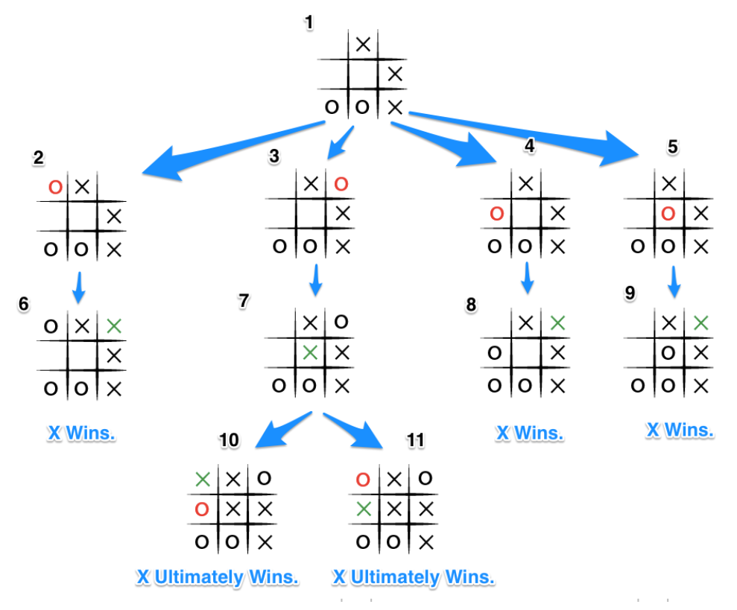
Tic-Tac-Toe Winner Prediction. Artificial intelligence VS Machine learning.
Presented by:
Tzach Cohen – 205650310.

Slide 2
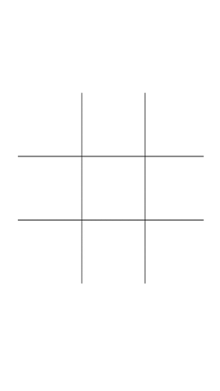
Introduction
My goal in this project is to build machine learning model that based on a given end states of tic tac toe boards, I’ll try to predict the winner of a specific game.
In the end, I want to successfully predict with high percentage for all the algorithms if X is the winner or X lost.
After that I’ll make a battle between AI algorithm (MinMax) and ML algorithms (Logistic Regression, Decision Tree, KNN).
My project is divided into 2 parts:
Based on end games states boards, predict the winner of specific game.
A Battle: AI vs. ML, who would win?

Slide 3
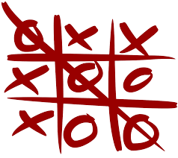
Dataset:
The dataset is from UCI machine learning Repository and called : “Tic-Tac-Toe Endgame dataset” .
link: https://archive.ics.uci.edu/ml/datasets/Tic-Tac-Toe+Endgame
The dataset contain all the possible configurations of end game states of tic-tac-toe, where “x” is assumed to have played first.
We only interested in X, meaning, we said “true” when x has one of the 8 possible ways to create a three-in-a-row (i.e winner situation).
Total number of legit tic-tac-toe endgame boards : 958.
Number of attributes: 9 (each one fit to one tic-tac-toe square).

Slide 4
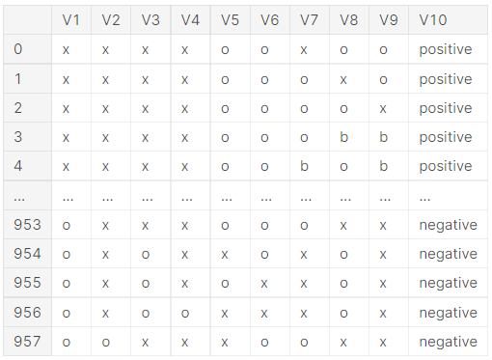
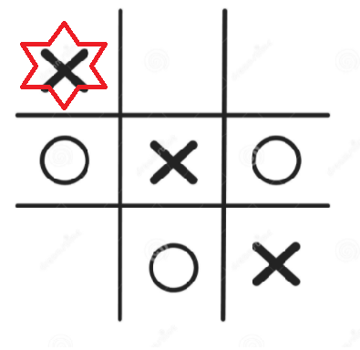
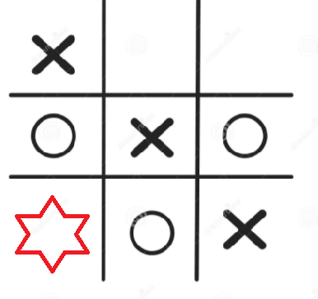
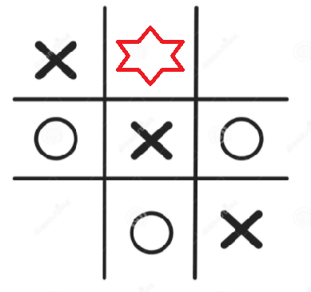
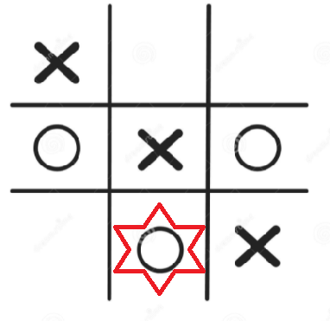
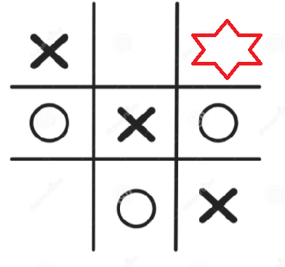
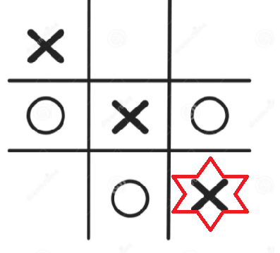
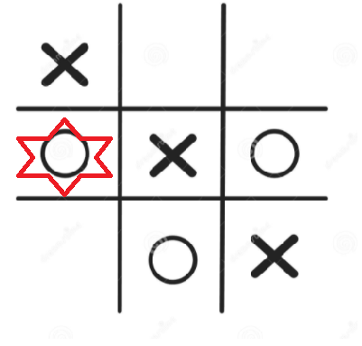
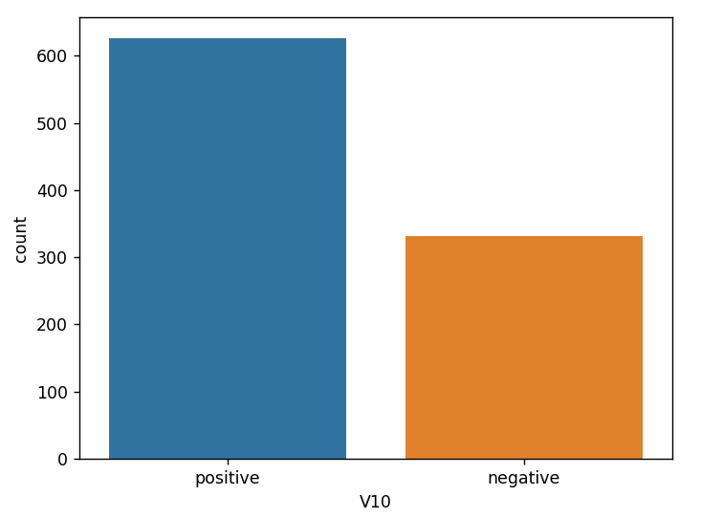
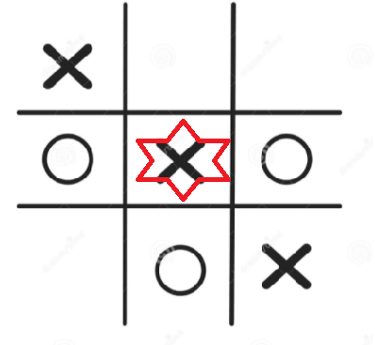
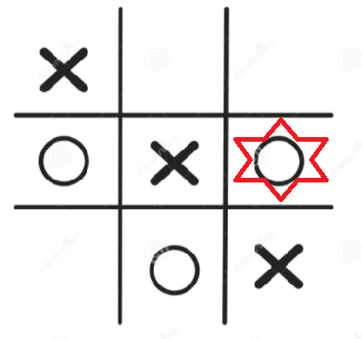
Attribute Information:
V1 = top left square
V7 = bottom left square
V2 = top middle square
V8 = bottom middle square
V3 = top right square
V9 = bottom right square
Class Distribution: About 65.3% are positive (i.e., wins for "x")
V10 = Class {Positive,Negative}
Means if X won or lost.
V4 = middle left square
V5 = middle middle square
V6 = middle right square

Slide 5
Thoughts and questions:
As I started this project the biggest question was "which algorithms performs best?“, and when I dig into more questions pops up.
Pre-processing.
This dataset looks prefect for decision trees so I assumed it will be the best result. I prove myself wrong.
I was also curious how the ML algorithms would preform against AI algorithms like MinMax. It make sense that at the start ML will lose (depends on how good the dataset is) but as we progress ML should make a comeback.
My algorithms:
Decision tree.
Logistic regression.
KNN.
Adaboost.
SVM.

Slide 6
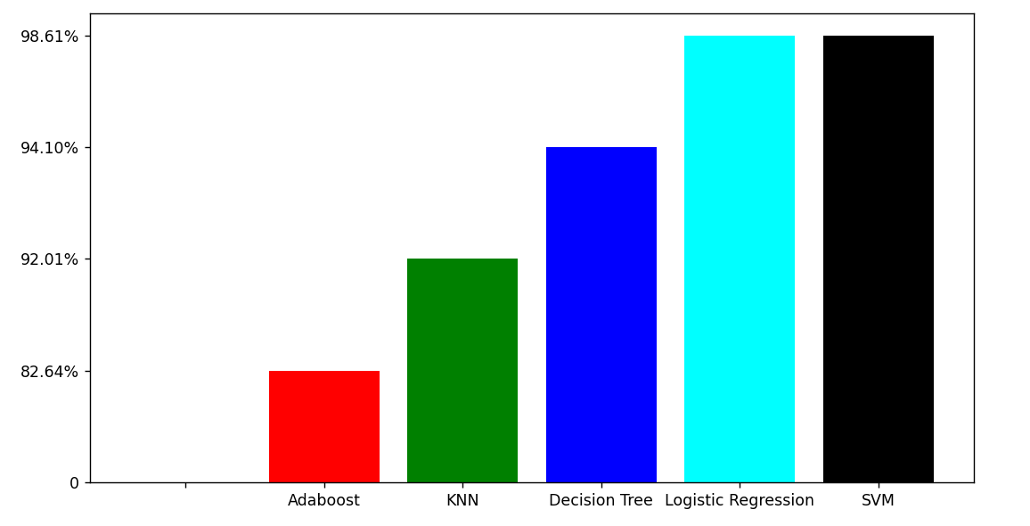
Results:
Interesting things:
I expected Decision tree to be higher, maybe try entropy.
Logistic Regression and SVM have the same accuracy but there’s still misclassification in both of them, why is that?

Slide 7
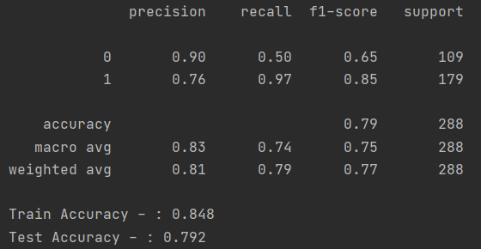
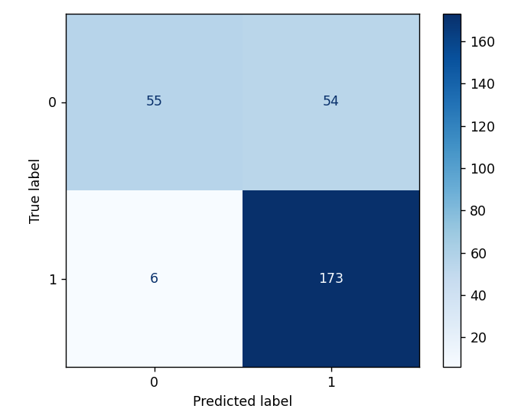
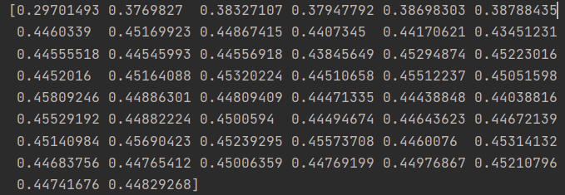
Worst-AdaBoost

Slide 8
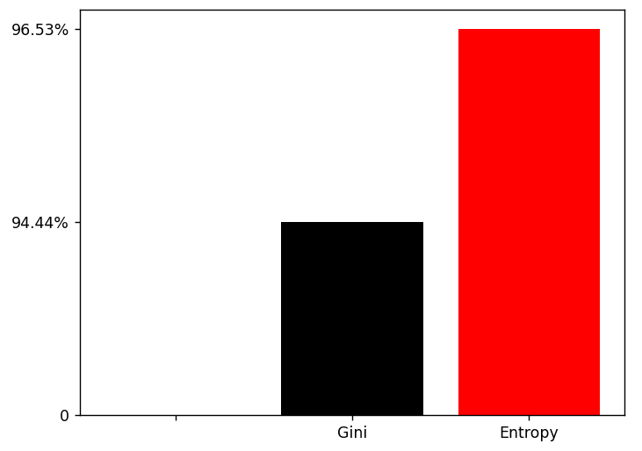
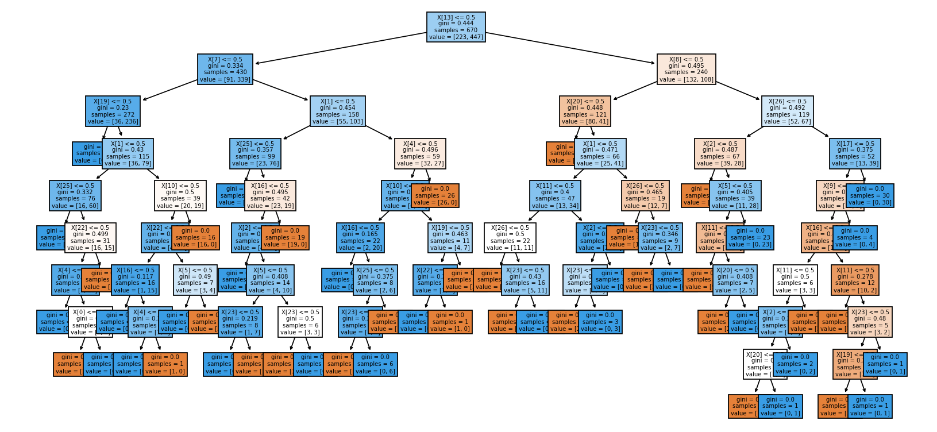
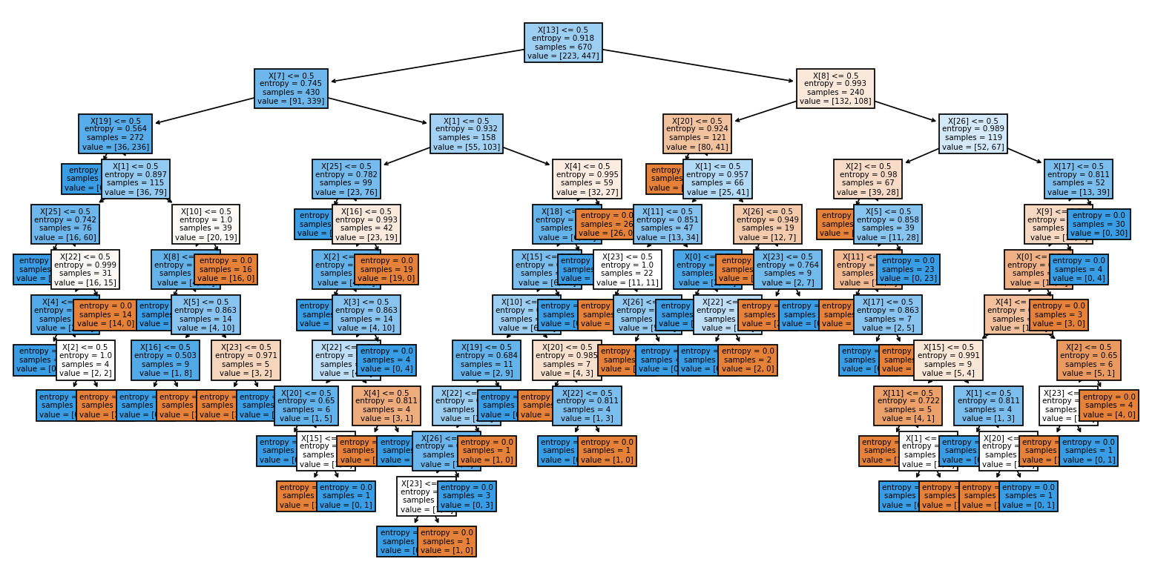
Let's explore Decision tree:
I was wondering if Decision tree using Entropy will show better score, lets see:
Gini:
Depth: 9.
Entropy:
Depth: 11.

Slide 9
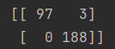
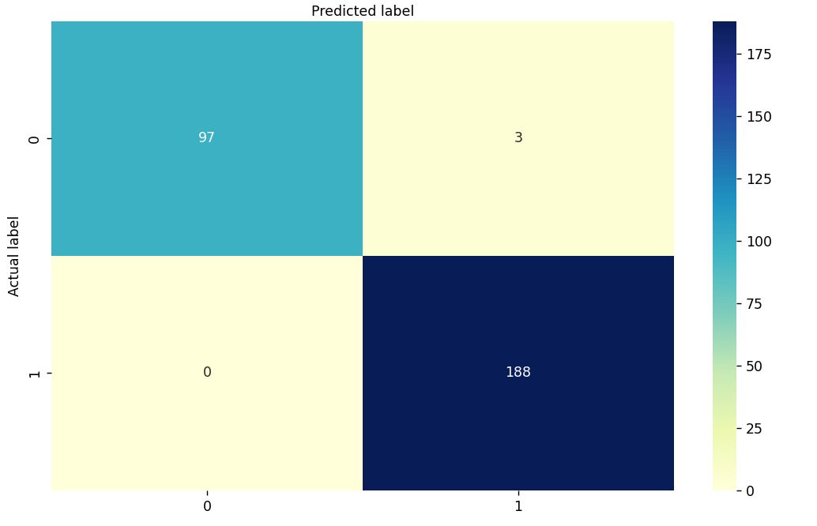
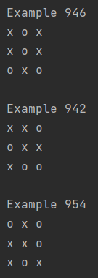
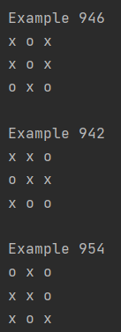
Explore misclassification:
Confusion matrix
As mentioned, SVM and Logistic Regression preforms with the best results, but in both of them there’s still misclassification:
True positives
False positives
Logistic Regression
SVM
False negatives
True negatives
Conclusions:
We can see that the algorithms gives wrong prediction when the game is tie.
So I do wonder if “tie” is consider X lost?
Those boards gives our model hard time.
In the data set they mentioned only X won or X lost, so I believe this game board are to check attention, because tie isn’t a lost in my opinion.
Gives us 3 wrong predictions, gave true (X won) but actually X lost?

Slide 10
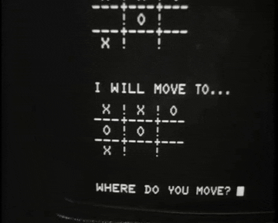
Conclusions so far:
We saw the problems in “tie” games.
SVM worked really well on this data since the data pretty small and simple, there’s small different between linear and non-linear, non-linear shows 97.57% accuracy while linear shows 98.61%.
Logistic Regression also preform really well on this data, but unlike SVM, here we have bigger different between Linear and logistic regressions. Logistic preforms with 98.61% accuracy and Linear with only 94.34%. I’m assuming it’s the reason is the constraints on the problem that Logistic Regression create. ([0-1]).
Whats next?
Now I got curious, what would happen if I make a battle between ML algorithms and AI algorithms? Who would win most of the time?
How ML responed?, since we need to make a new data now.

Slide 11
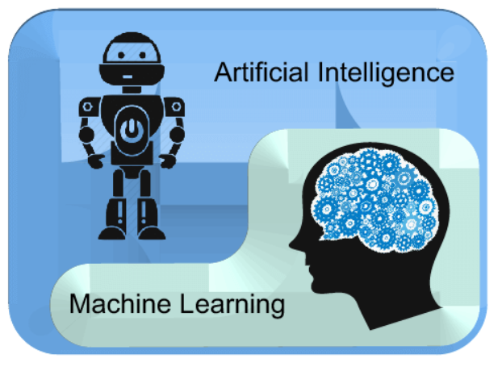
Machine Learning VS. Artificial intelligence
Challenges:
Need to make my own data.
How to make the board compitable with AI.
Implements of AI algorithms.
how I did it?
I implemented simple tic tac toe game with move,validation,checkWinner and check row/col/diagonals methods.
GenerateNewRow and getNewData – methods that make temp dataset after every move basically generate data so we can train our model.
Extended to TicTacToeAI added method that necessary to make it compitable with AI.
Implemented MinMax class with bestMove and minmax methods.
Logistic Regression class with bestMove (prediction) ,training and addData methods.
Implements Random move generator (To train the model I’m doing random walk VS minmax ).

Slide 12
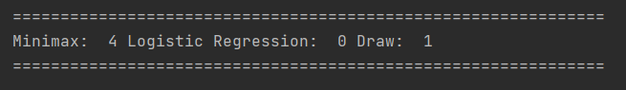
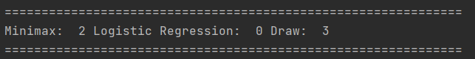
Logistic Regression VS. minMax
❌
⭕
MinMax is optimal algorithm for tic tac toe game, therefor it’s always unbeatable. Logistic Regression can be unbeatable as well but that’s depends on how good is the dataset. As we saw, Logistic Regression can lose first few matches if the model is not trained well, and because we training the model with random walk, it’s not always good, BUT since we training the model after each match, Logistic Regression will definitely make a come back. | When we have larger dataset then it can make up for the bad random move training. Meaning the more data we have the more chances the model knows how to act again the minMax.
Click for full output

Slide 13
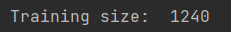
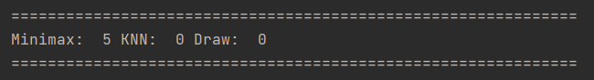
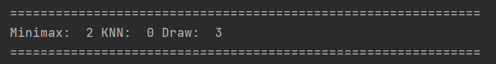
K-Neighbor VS. minMax
❌
⭕
minMax is optimal algorithm for tic tac toe game, therefor it’s unbeatable. Unlike Logistic Regression, In KNN I saw case when we make a draw but still lost the next few games, so again we really depends on the data. Since its random the training not always good. | In larger dataset we can see that our model learn better, and KNN make a come back real quick. It’s only make sense since the larger the dataset is, we have more states and moves that the model learned so he can react better to what minMax algorithm does.

Slide 14
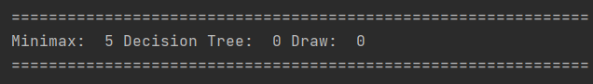
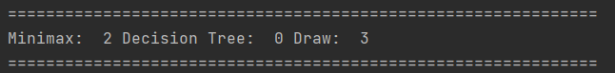
Decision Tree VS. minMax
❌
⭕
We heavily depends on the quality of the data and since we generate data with random walk, the quality is not that great. In decision tree if I run across a game I have never seen before, the decision tree will have no possible response since it can't predict values for games it has never been trained on. Furthermore some boards may not make it into the tree at all. | I had to increase the size of the data in order to get better results. The larger the data the more chances to see different boards situations.

Slide 15
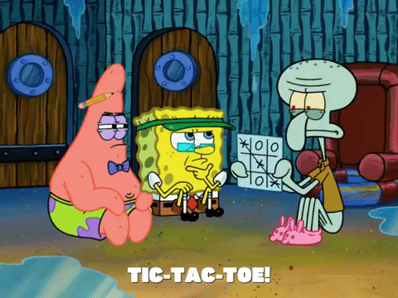
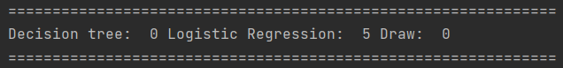
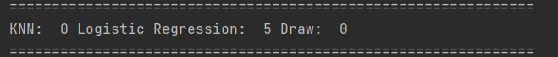
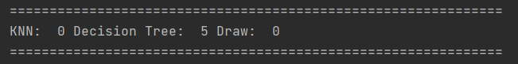
Additional experiments for fun:
Logistic Regression VS. Decision Tree
Logistic Regression VS. KNN
Logistic Regression VS. Convolutional Neural Network = not sure about my implementation for CNN (got help from Wiki) but Logistic Regression won 5:0, It make sense to me that CNN didn’t preform well on this small board so it’s hard to capture patterns ,so I assume Neural Network on this small board actually acting like random walk.
Decision Tree VS. KNN
When I’m predicting something like game state for the purposes of making a move on the other hand, “good enough” is a lot more difficult. I need to predict a legal move, a non-losing move, and preferably a winning move.

Slide 16

Places for improvements:
MinMax can perform faster with alpha-beta prouning – at high training size the algorithm take so long to run.
Overfitting:
Better approach to generate data instead of random move, I can’t generate all possible data with this thus some Machine Learning algorithms failed to learn properly.
Generate larger data. (Only after alpha-beta prouning improve).

Slide 17
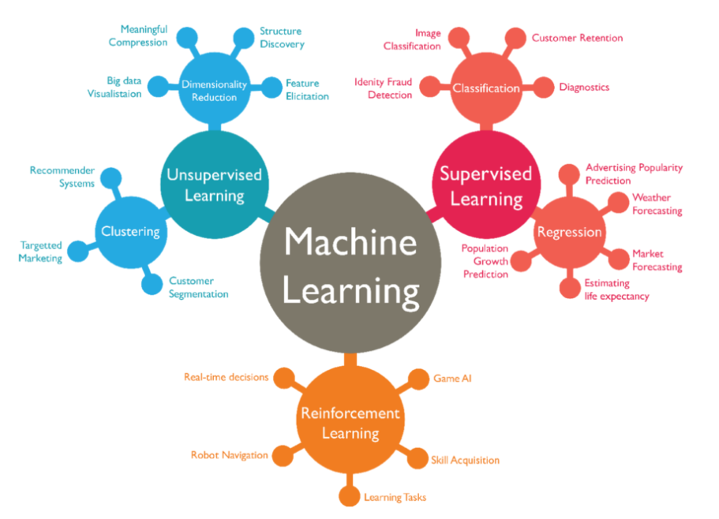
Sources and references:
Dataset: https://archive.ics.uci.edu/ml/datasets/Tic-Tac-Toe+Endgame
Tic-Tac-Toe Learning Using Artificial Neural Networks -> here
Thank you!

